Slide 1
Design Report
How to learn uku step by step?
Chun Yi Huang
ETEC 644

Slide 2
How to learn uku step by step?
1. Topic:
Develop strategies that can assist ukulele beginners. During my instructional product I'm aiming to clarify basic steps about how to step by step learning ukulele.
2. Goal Statement:
The ukulele learning website, beginners just only following this guide and they'll be able to have fun with the ukulele and enjoy music in any time/ anywhere. Beginner will learn 5-10 basic chords on this website.

Slide 3
Website Navigation Menu
How to learn uku step by step?
HOW TO STEP BY STEP LEARNING UKULELE
HOME
ABOUT
HISTORY
TUNER
CHORDS
GUIDES
CONTACT
PAYPAL
Focus on basic 5-10 basic chords

Slide 4
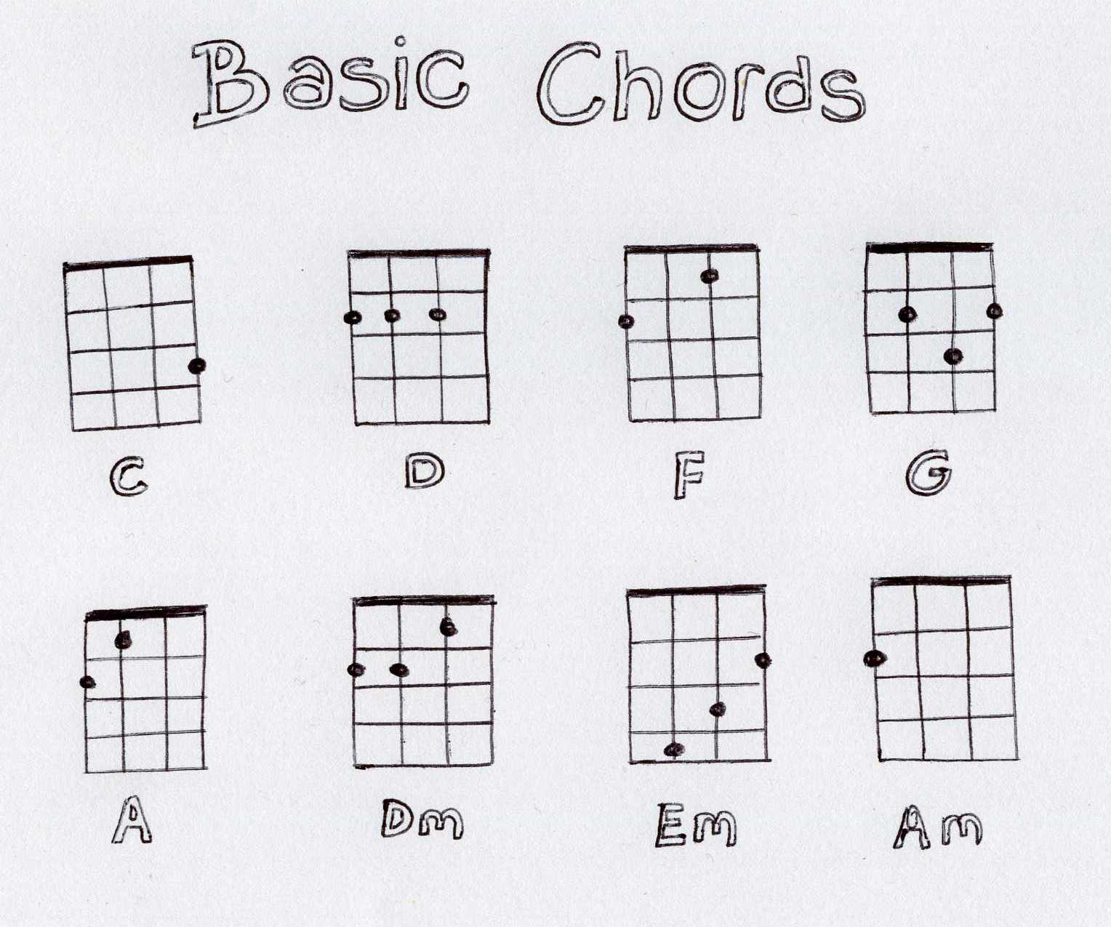
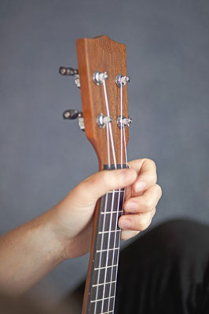
How to learn uku step by step?
CHORDS

Slide 5
Q & A

